Slide 1
RIPv2
Routing Protocols and Concepts – Chapter 7

Slide 2
Objectives
Encounter and describe the limitations of RIPv1’s limitations.
Apply the basic Routing Information Protocol Version 2 (RIPv2) configuration commands and evaluate RIPv2 classless routing updates.
Analyze router output to see RIPv2 support for VLSM and CIDR.
Identify RIPv2 verification commands and common RIPv2 issues.
Configure, verify, and troubleshoot RIPv2 in “hands-on” labs.

Slide 3
Introduction
Chapter focus
  Difference between RIPv1 & RIPv2
    RIPv1
      A classful distance vector routing protocol
      Does not support discontiguous subnets
      Does not support VLSM
      Does not send subnet mask in routing update
      Routing updates are broadcast
    RIPv2
      A classless distance vector routing protocol that is an enhancement of RIPv1’s features
      Next hop address is included in updates
      Routing updates are multicast
      The use of authentication is an option

Slide 4
Introduction
Similarities between RIPv1 & RIPv2
  Use of timers to prevent routing loops
  Use of split horizon or split horizon with poison reverse
  Use of triggered updates
  Maximum hop count of 15

Slide 5
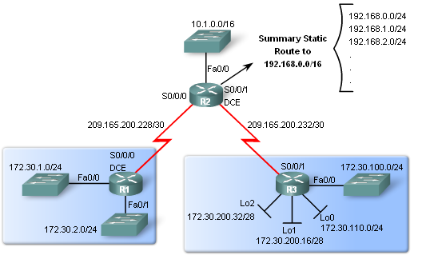
RIPv1 Limitations
Lab Topology
Scenario:
  3 router set up
  Topology is discontiguous
  There exists a static summary route
  Static route information can be injected into routing table updates using redistribution
  Routers 1 & 3 contain VLSM networks

Slide 6
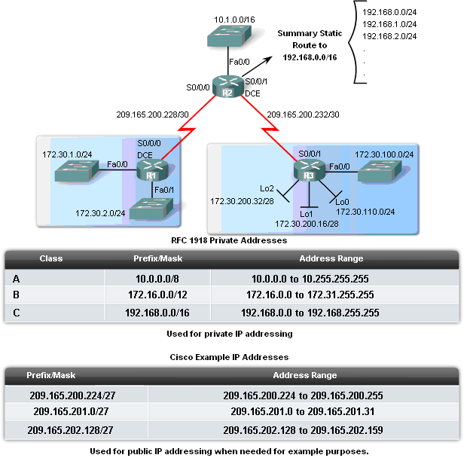
RIPv1 Limitations
Scenario Continued
VLSM
  Recall this is sub netting the subnet
Private IP addresses are on LAN links
Public IP addresses are used on WAN links
Loopback interfaces
  These are virtual interfaces that can be pinged and added to routing table

Slide 7
RIPv1 Limitations
Null Interfaces
  This is a virtual interface that does not need to be created or configured
    Traffic sent to a null interface is discarded
    Null interfaces do not send or receive traffic
Static routes and null interfaces
  Null interfaces will serve as the exit interface for static route
    Example of configuring a static supernet route with a null interface
    R2(config)#ip route 192.168.0.0 255.255.0.0 Null0

Slide 8
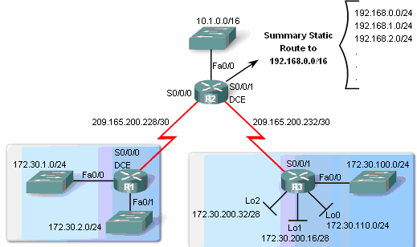
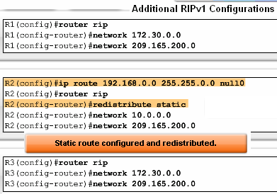
RIPv1 Limitations
Route redistribution
  Redistribution command is way to disseminate a static route from one router to another via a routing protocol
  Example
    R2(config-router)#redistribute static

Slide 9
RIPv1 Limitations
Verifying and Testing Connectivity
  Use the following commands:
    show ip interfaces brief
    ping
    traceroute

Slide 10
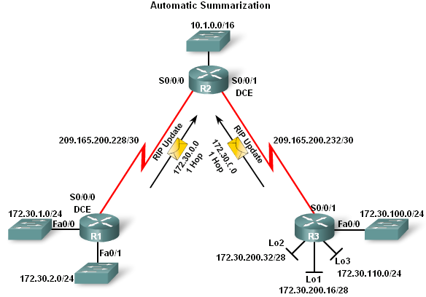
RIPv1 Limitations
RIPv1 – a classful routing protocol
  Subnet mask are not sent in updates
  Summarizes networks at major network boundaries
  If network is discontiguous and RIPv1 configured convergence will not be reached

Slide 11
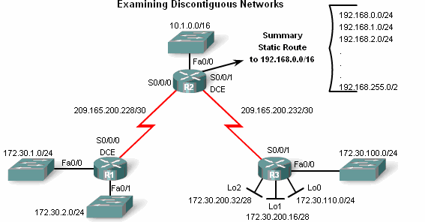
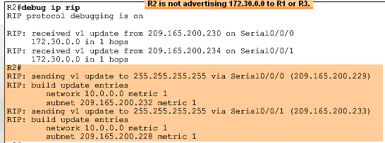
RIPv1 Limitations
Examining the routing tables
  To examine the contents of routing updates use the debug ip rip command
  If RIPv1 is configured then Subnet masks will not be included with the network address

Slide 12
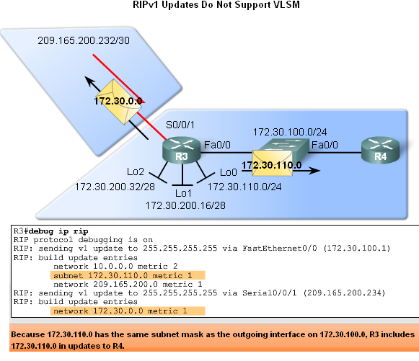
RIPv1 Limitations
RIPv1 does not support VLSM
  Reason: RIPv1 does not send subnet mask in routing updates
RIPv1 does summarize routes to the Classful boundary
  Or uses the Subnet mask of the outgoing interface to determine which subnets to advertise

Slide 13
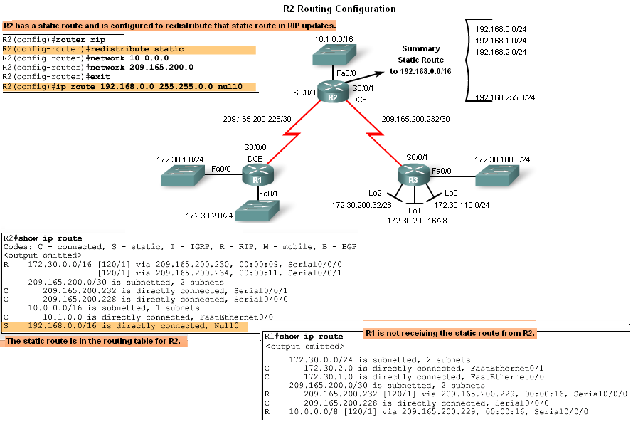
RIPv1 Limitations
No CIDR Support
In the diagram R2 will not include the static route in its update
  Reason: Classful routing protocols do not support CIDR routes that are summarized with a smaller mask than the classful subnet mask

Slide 14
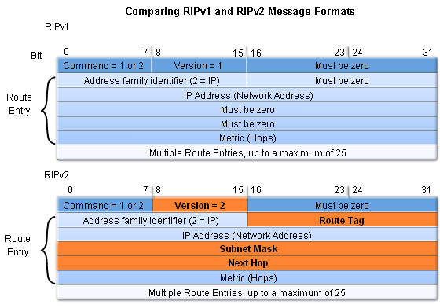
Configuring RIPv2
Comparing RIPv1 & RIPv2 Message Formats
  RIPv2 Message format is similar to RIPv1 but has 2 extensions
    1st extension is the subnet mask field
    2nd extension is the addition of next hop address

Slide 15
Configuring RIPv2
Enabling and Verifying RIPv2
Configuring RIP on a Cisco router
  By default it is running RIPv1

Slide 16
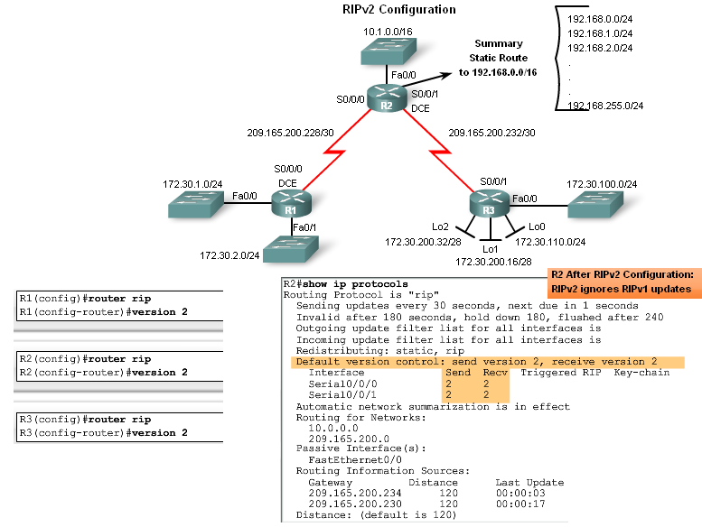
Configuring RIPv2
Configuring RIPv2 on a Cisco router
  Requires using the version 2 command
  RIPv2 ignores RIPv1 updates
To verify RIPv2 is configured use the
  show ip protocols command

Slide 17
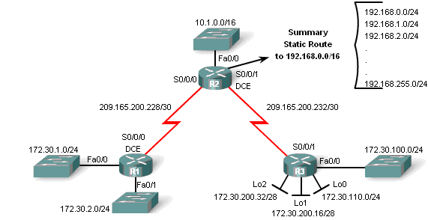
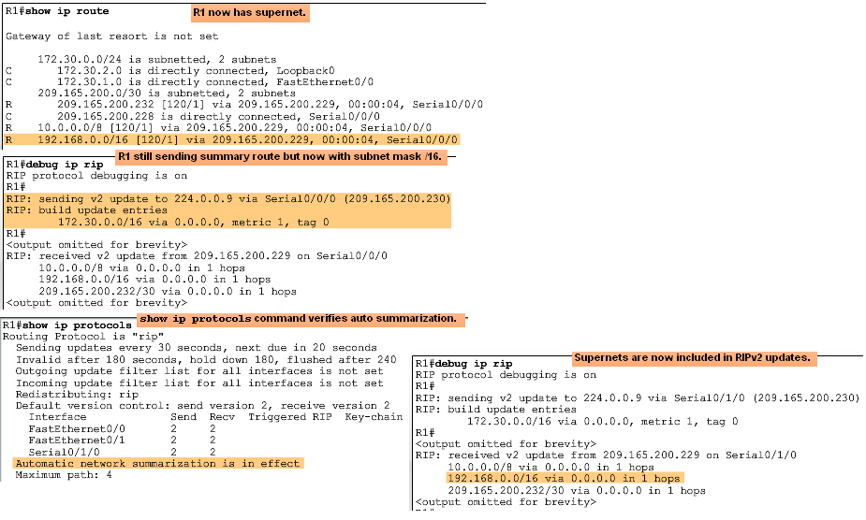
Configuring RIPv2
Auto-Summary & RIPv2
RIPv2 will automatically summarize routes at major network boundaries and can also summarize routes with a subnet mask that is smaller than the classful subnet mask

Slide 18
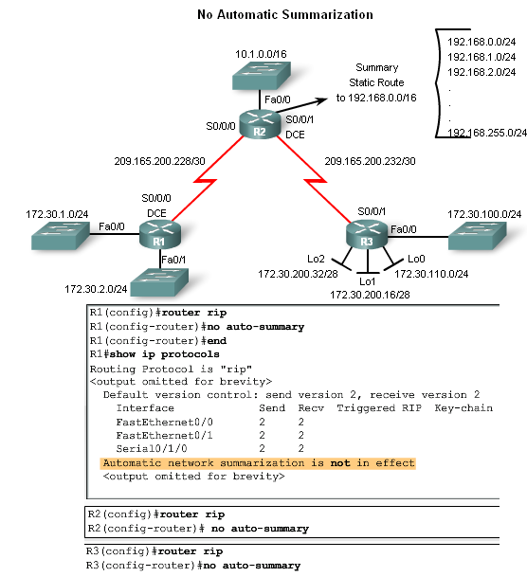
Configuring RIPv2
Disabling Auto-Summary in RIPv2
To disable automatic summarization issue the no auto-summary command

Slide 19
Configuring RIPv2
Verifying RIPv2 Updates
When using RIPv2 with automatic summarization turned off
  Each subnet and mask has its own specific entry, along with the exit interface and next-hop address to reach that subnet
To verify information being sent by RIPv2 use the
  debug ip rip command

Slide 20
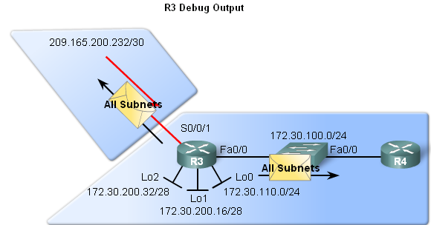
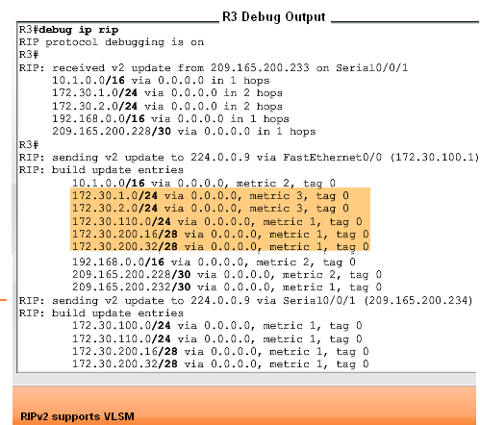
VLSM & CIDR
RIPv2 and VLSM
Networks using a VLSM IP addressing scheme
  Use classless routing protocols (i.e. RIPv2) to disseminate network addresses and their subnet masks

Slide 21
VLSM & CIDR
CIDR uses Supernetting
  Supernetting is a bunch of contiguous classful networks that is addressed as a single network

Slide 22
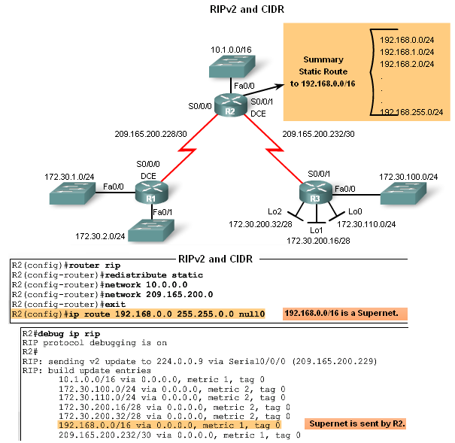
VLSM & CIDR
To verify that supernets are being sent and received use the following commands
  Show ip route
  Debug ip rip

Slide 23
Verifying & Troubleshooting RIPv2
Basic Troubleshooting steps
  Check the status of all links
  Check cabling
  Check IP address & subnet mask configuration
  Remove any unneeded configuration commands
Commands used to verify proper operation of RIPv2
  Show ip interfaces brief
  Show ip protocols
  Debug ip rip
  Show ip route

Slide 24
Verifying & Troubleshooting RIPv2
Common RIPv2 Issues
When trouble shooting RIPv2 examine the following issues:
  Version
    Check to make sure you are using version 2
  Network statements
    Network statements may be incorrectly typed or missing
  Automatic summarization
    If summarized routes are not needed then disable automatic summarization

Slide 25
Verifying & Troubleshooting RIPv2
Reasons why it’s good to authenticate routing information
  Prevent the possibility of accepting invalid routing updates
  Contents of routing updates are encrypted
Types of routing protocols that can use authentication
  RIPv2
  EIGRP
  OSPF
  IS-IS
  BGP

Slide 26
Summary
Routing Protocol | Distance Vector | Classless Routing Protocol | Uses Hold-Down Timers | Use of Split Horizon or Split Horizon w/ Poison Reverse | Max Hop count = 15 | Auto Summary | Support CIDR | Supports VLSM | Uses Authen-tication
RIPv1 | Yes | No | Yes | Yes | Yes | Yes | No | No | No
RIPv2 | Yes | Yes | Yes | Yes | Yes | Yes | Yes | Yes | Yes

